Slide 1

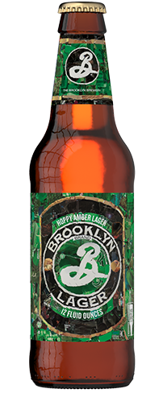
Miner League
Brandon Croom
Sangrae Cho
Sandesh Ojha
Beers and Breweries of America

Slide 2
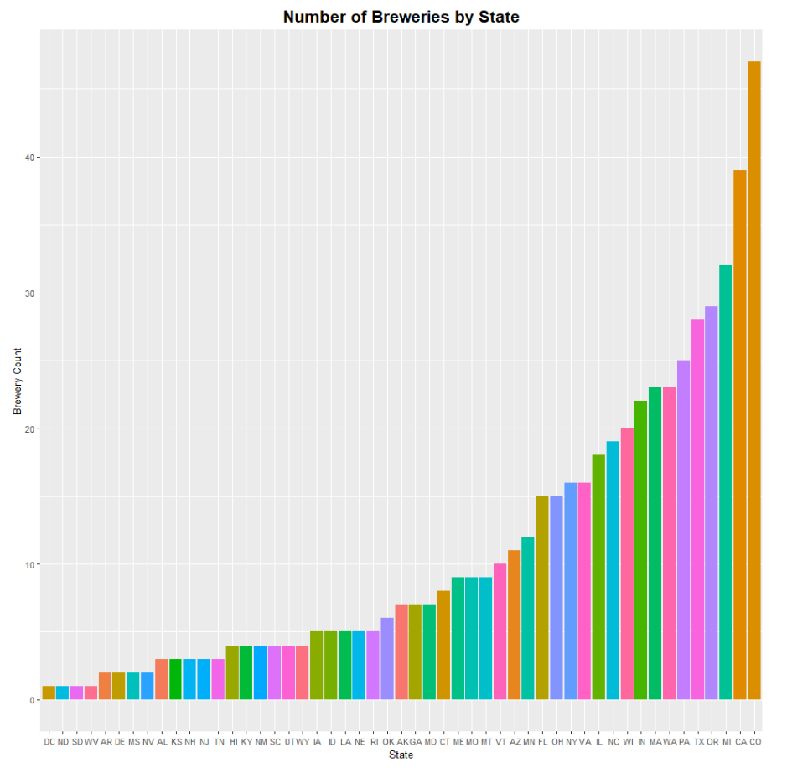
There are 558 Breweries which make Around 2,400 different types of Beers in the United States
1
The top 5 states produce 865(36%) of beers and represent 31% of the breweries in the US
These states include Colorado, California, Michigan, Oregon and Texas.
Two of the biggest states by population and size Texas and California also happen to have a lot of breweries than many other smaller states.
Despite not being a top 10 states based on size or population Michigan is one of the largest producers of beers in the US.
1
2
The bottom 20 states only produce x# of beers and only represent 10% of the breweries in the US
Despite it’s size and population New Mexico is one of the lowest producer of beer and only has 4 breweries.
2
Disclaimer : This analysis is based on a sample dataset

Slide 3
Even states with less than 5 Breweries produce Variety of Beers
Need to create this chart in R
2
1
1
Washington DC and Kansas have less than 5 breweries but per brewery they produce the highest numbers of beers at around 8.
The top 5 states produce around 5 different types of beers per brewery.
2
Disclaimer : This analysis is based on a sample dataset

Slide 4
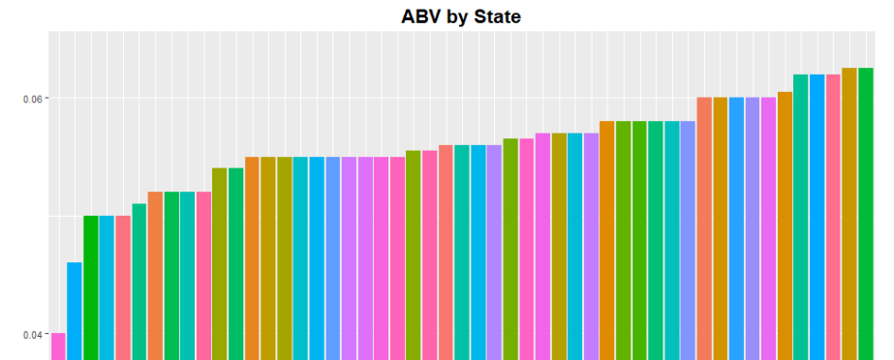
5% ABV Is becoming the Norm and there are select beers with much Higher ABV(10-13%)
1
2
Need to create this chart in R
1
Beers brewed in Utah and New Jersey average between 4-5% for ABV, most other States are 5% or higher.
36% of the beers are between 5-6% ABV and 21% between 6-7% ABV which represents more than half of the total beers.
2
Disclaimer : This analysis is based on a sample dataset

